Slide 1
Agile and Empathy
How Developers and Project Managers can work together to create a better workplace environment
By Jackie Henson

Slide 2
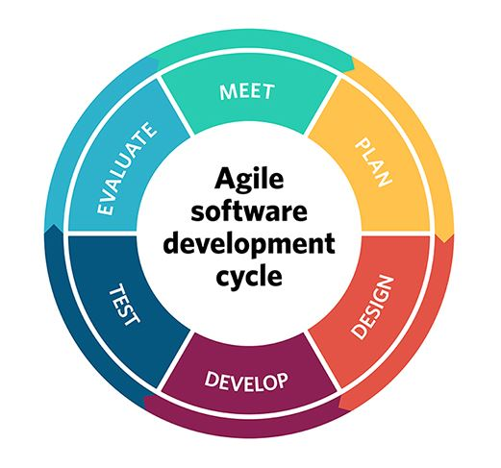

Understanding Agile
Breaking the project into phases which emphasizes continuous collaboration and improvement.
Works well from a CI/CD pipeline standpoint, iterative development that allows for setbacks/problems to be quickly identified and solved
Allows for teams to be adaptable and work collaboratively via scrum meetings, standups, and retrospectives

Slide 3
The Role of Empathy in Agile:
Empathy - from HBR - “the act of putting yourself in someone else's problem in the hopes of understanding, of bridging a gap”
We ALL want to be seen, heard, and understood. We are all working towards the same goal, and opinions or ideas to a given project all matter to its success
By asking questions to understand others perspectives, it allows for unique ideas that may not have been communicated otherwise, helps team members feel valued and respected
Better communication -> Effective meetings -> Happier team -> Iterative project design based on a successful teams valuable needs and strengths
Source: “Practice Empathy as a Team.” Harvard Business Review, 10 Feb. 2023, hbr.org/2023/02/practice-empathy-as-a-team.

Slide 4

Fostering Empathy for Developers:
In a survey of over 20,000 people, HBR found that a only 42% believed that their manager appreciated their work.
Empathetic project managers can better understand individual strengths, weaknesses, and motivators of team members, leading to improved task assignments and resource allocation
Developers can foster empathy with each other by inviting feedback and putting themselves in each others shoes to better solve problems
What this might look like:
Kira, a Project Manager, knows that one of her developers Casey, wants to pursue more front-end work to grow his career. She makes sure to ask Casey if he would like to take on the front-end ticket, knowing that his skillset and enthusiasm align with the project, and in turn will help make a better product and happier team.
Alex, a developer, asks for feedback to make sure his team agrees with his solution to a solve a tough coding problem. While he may feel confident he has a working solution, he also knows that his team has valuable feedback and input that could make the end result even better, or catch edge cases he hadn’t considered
Source: “Practice Empathy as a Team.” Harvard Business Review, 10 Feb. 2023, hbr.org/2023/02/practice-empathy-as-a-team.

Slide 5

Fostering Empathy for Leadership:
Project Managers and Leadership have their own roles to balancing timelines, budgets, and stakeholder expectations, all of which require adept planning and communication skills.
As developers, by putting ourselves into a project manager's shoes, we gain insight into their decision-making processes and priorities.
Developers should understand the pressures project managers encounter, such as managing budgets, timelines, and stakeholder expectations
What this might look like:
Heather, a dev, knows that Kira has to return to her stakeholders with news about why a project is taking longer than expected. Heather can propose alternative solutions or suggestions that may help expedite the project or minimize further delays. This proactive approach demonstrates empathy towards Kira's position, and shows a willingness to contribute to the project's success.

Slide 6
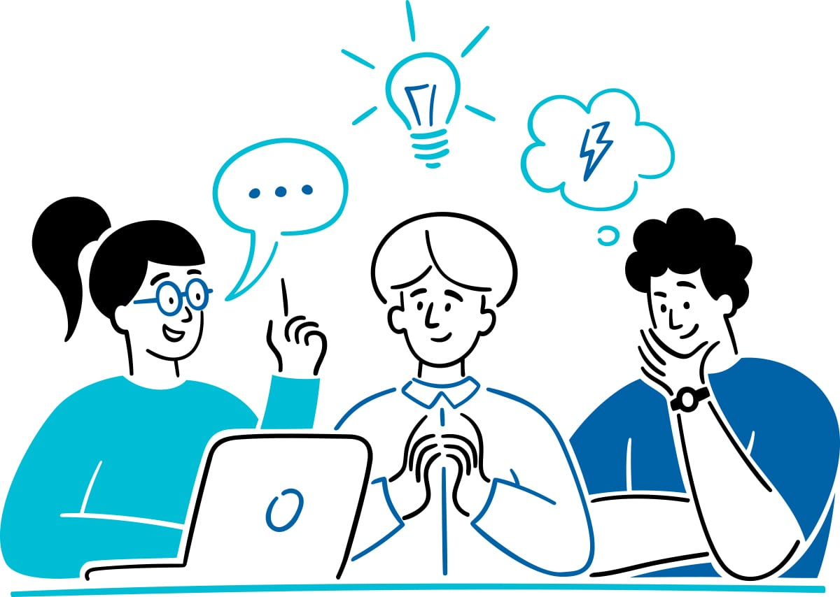
Other ways to Practice Agile With Empathy:
Pair Programming with Empathy Pairs: Pair programming, a common practice in Agile development, can be enhanced by assigning unique pairs. Team members can be intentionally paired with someone they may have less interaction with, thus fostering empathy by encouraging collaboration through understanding different perspectives.
User Story Mapping for Stakeholders - When creating user story maps, teams can include an empathy-driven component that focuses on understanding the needs, motivations, and challenges of end users/stakeholders. This helps teams develop a deeper understanding of the user's perspective, leading to more empathetic and user-centered product development.
Celebrating Successes and Milestones - In both Agile and Empathy, it's essential to celebrate team successes and milestones. By acknowledging and appreciating individual contributions, team and individual successes, team members and leaders feel a stronger sense of connection to the project and each other

Slide 7

Concluding Thoughts
Empathy enhances all aspects of Agile, not just among team members, but allows for a better overall development cycle and product in the long run.
This allows for a happier work environment that values people and individual ideas, creates better software, fosters a sense of community, and leads to a higher driven success based environment!
It allows for voices of everyone, regardless of background, to matter!
For this audience - how do you think you can embrace empathy as a core value in your development and project management practices?

Slide 8
Thank you!

